Slide 1
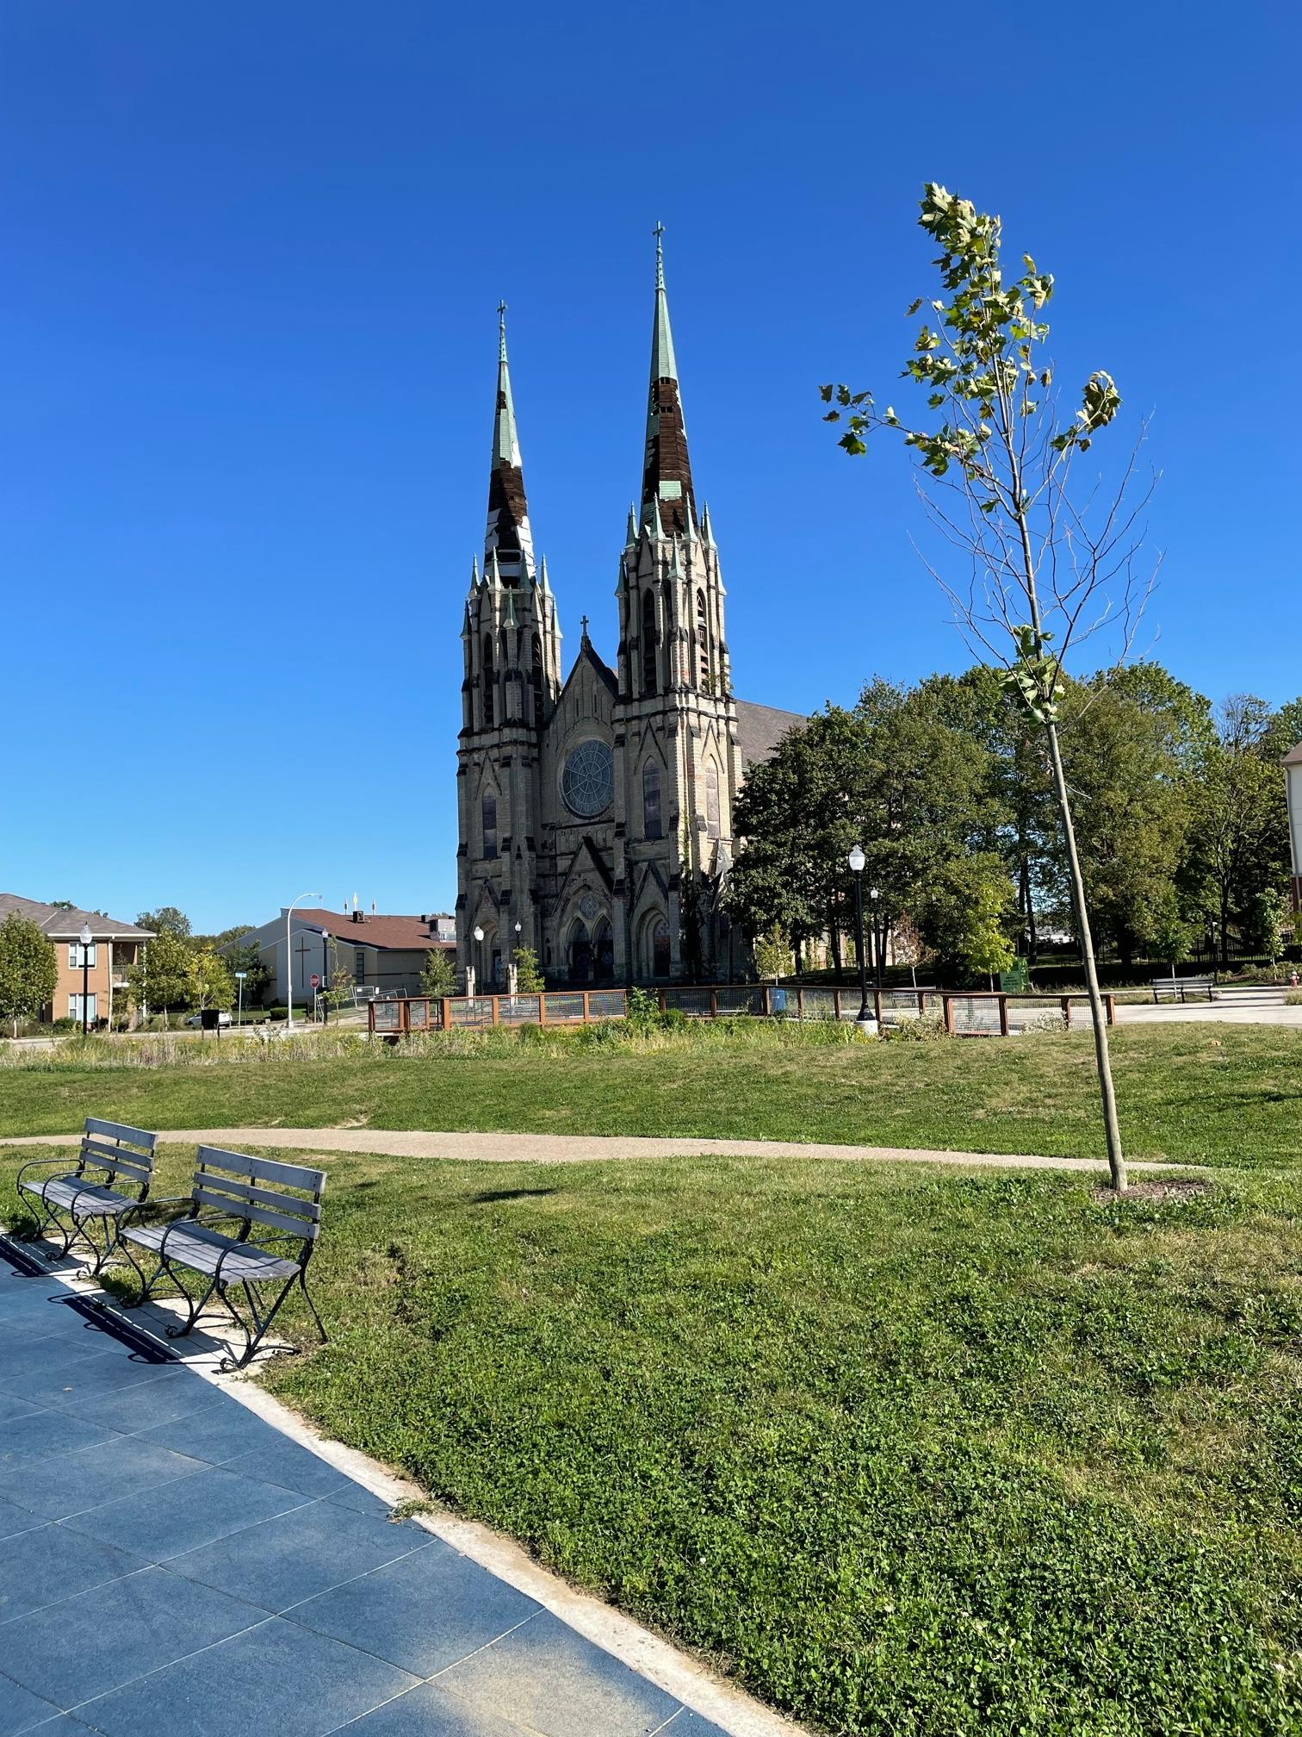
St. Peter and Paul Church
Clara Torres, Nathan Sawyer, and Sophie Abo
November 9, 2021

Slide 2
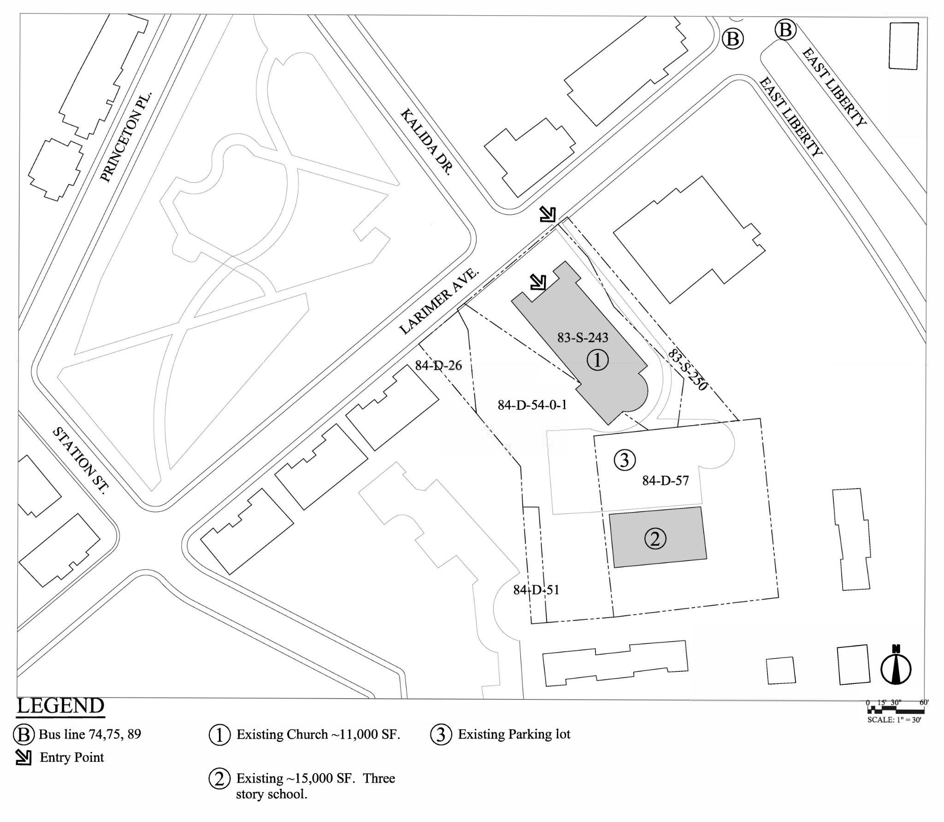
Existing Site Plan
Existing Zoning Types:
RM-M (Multi-Unit Moderate Density)
RP (Residential Planned unit development)
Front setbacks 25’
Rear setbacks 25’
Side yard setbacks 10’
Height Limit 55’
4 floor Maximum
Existing and proposed building types do not conform to zoning. A variance will need to be filed.

Slide 3
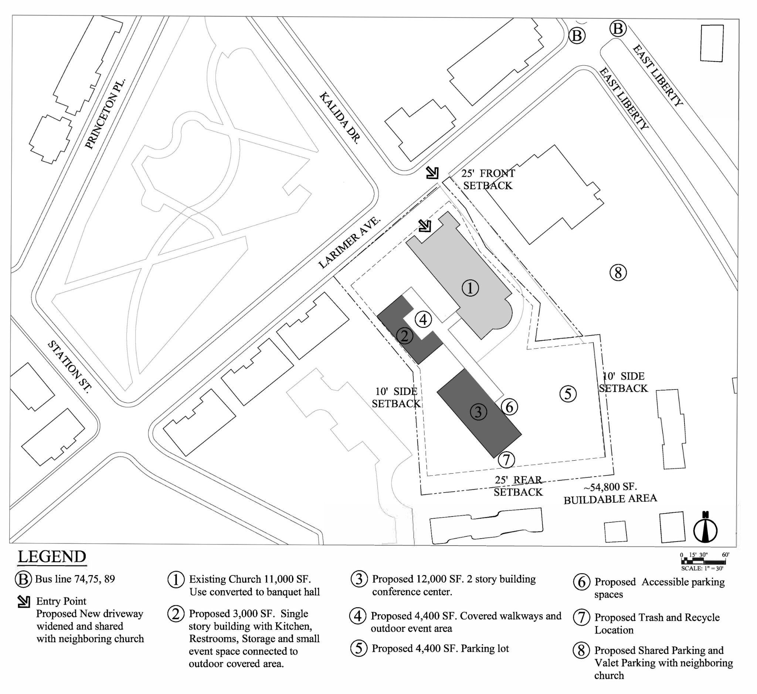
Proposed Site Plan
1 Existing church (~11,000 sf.)
2 Proposed 3,000 sf single story event building with kitchen, restrooms and storage.
3 Conference center (2 story, 12,000 sf.)
4 Covered walkways and outdoor event area
5 Proposed parking area
6 Proposed handicap parking
7 Trash and recycling location
8 Shared parking lot with neighboring church

Slide 4
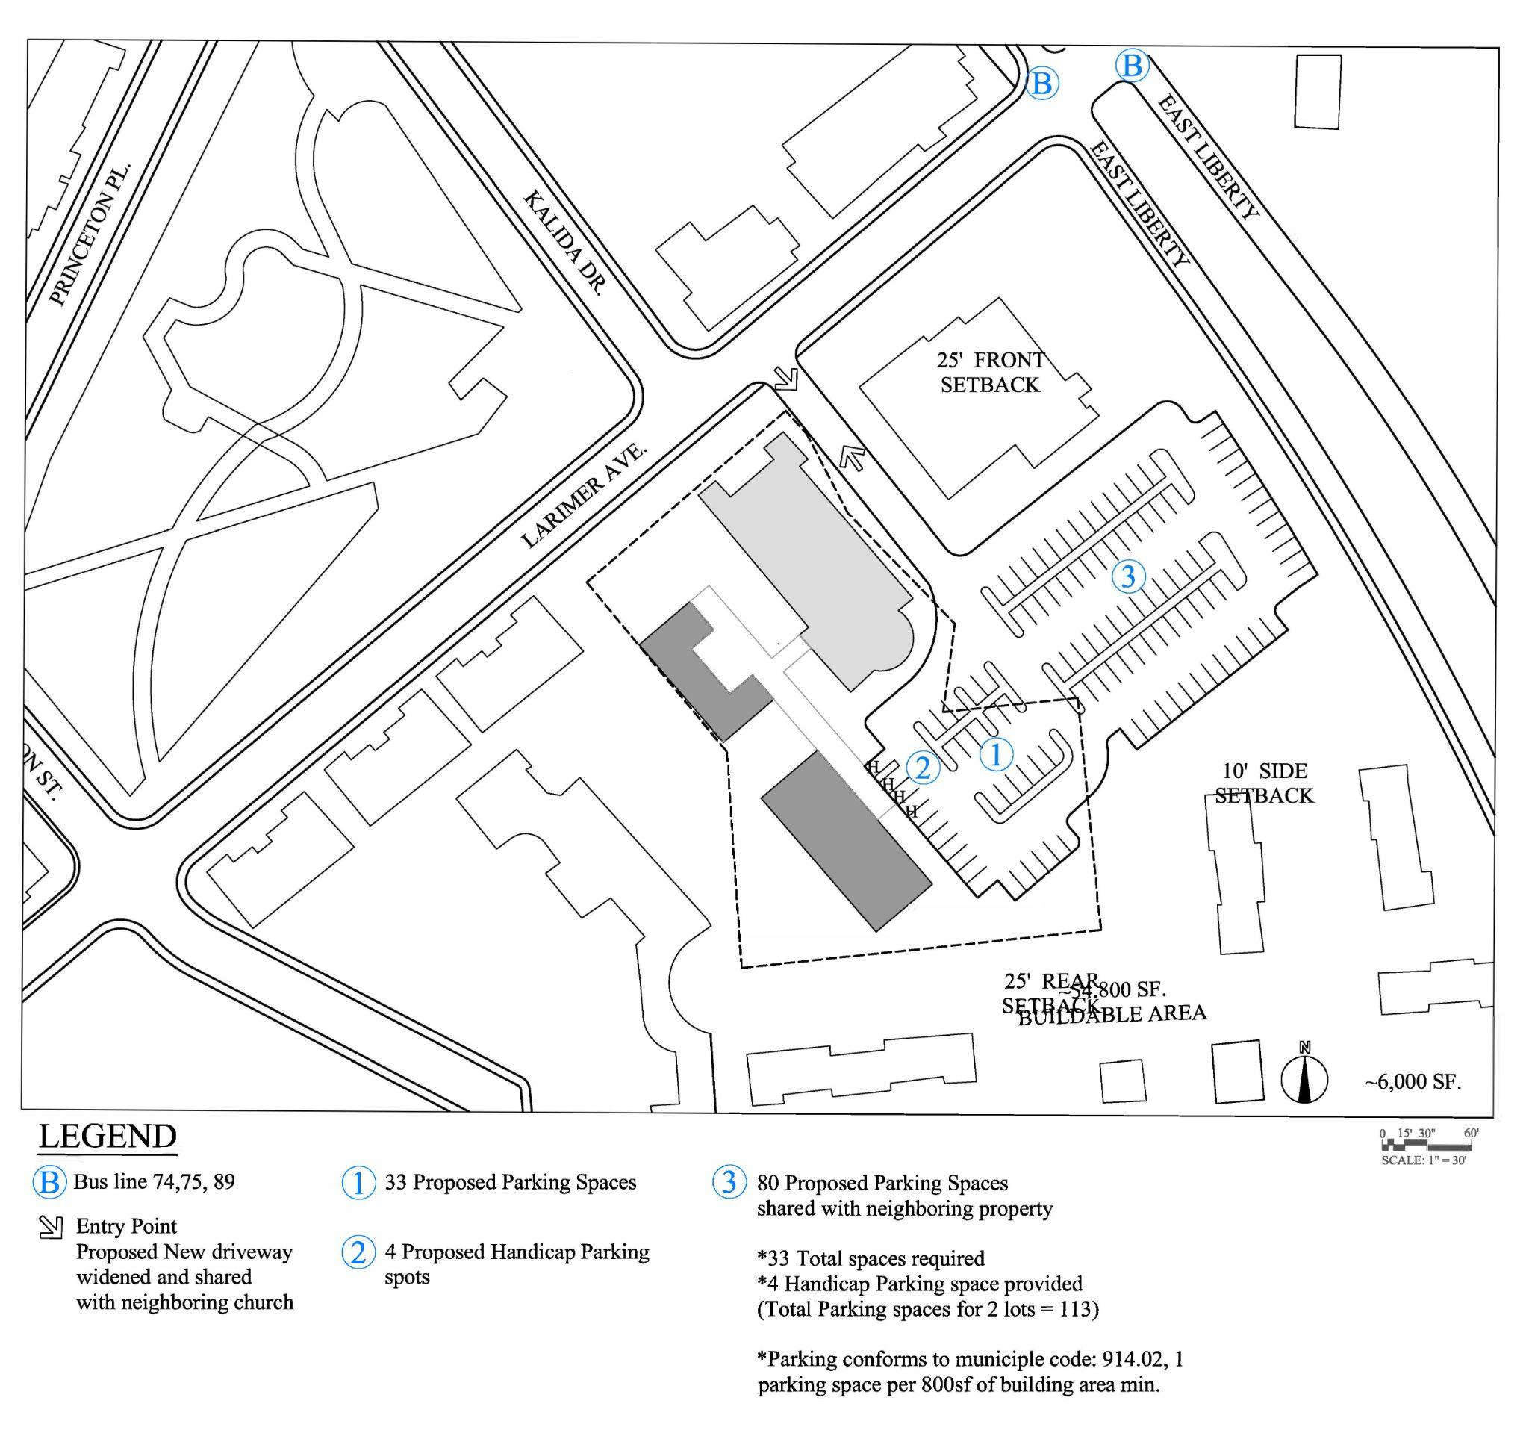
Parking
Requirements
33 spaces required
1 handicap space required per 25 parking spaces
Proposed
33 spaces proposed
4 handicap spaces
80 spaces available in adjoining lot
113 total spaces available

Slide 5
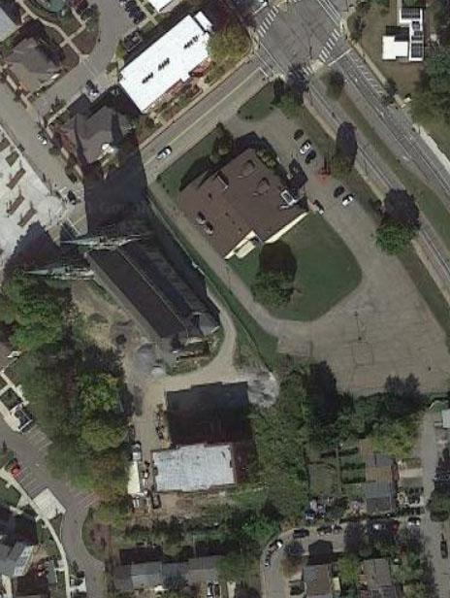
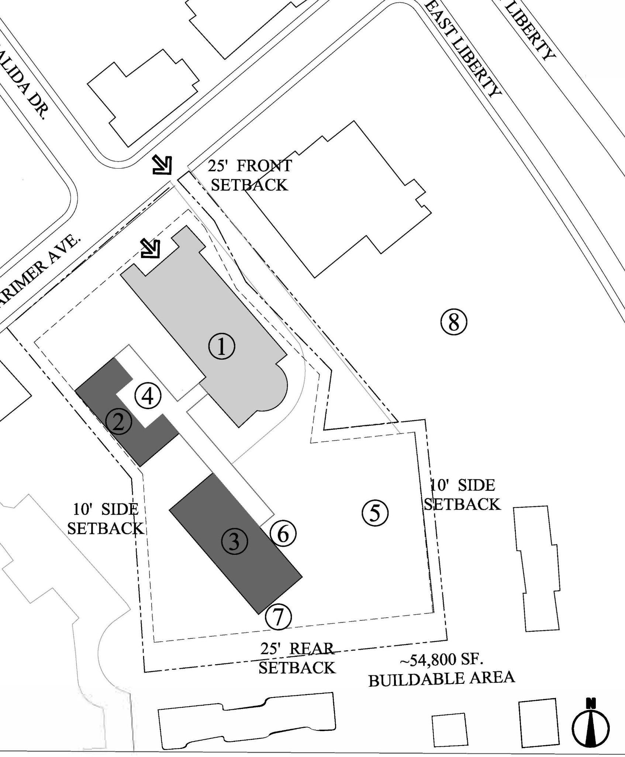

Outdoor Events
Possible Programing
Food truck (pull up at 6)
Small concerts
Picnics
Sports events: Yoga classes, martial arts
Amenities Provided
Seating and tables
Lighting
Equipment for different weather conditions, might include a tent
Restroom
Decoration

Slide 6
Event Hall Competition
 | Union Project | Grand Hall at the Priory | Aspinwall Riverfront | The Circuit Center and Ballroom | St. Nick's Cathedral Room
Size (sq ft) | 4,300 | - | - | 8,000 | -
Occupancy | 240 | 350 seated 500 standing | 250 seated 400 standing | 450 seated 700 standing | 525
Pricing | $625 / 4 hrs $5,000 wedding reception | $12-21 per person | $3,000 Sat $2,000 Fri and Sun. | Per person based on food | $2,000 - $3,000
Kitchen/ catering | Kitchen available | Yes | Catering available | Catering by Fluted Mushroom | Yes
Stage and Equipment | Yes | - | Yes | Yes | Yes
Parking | Street | - | Parking lot | Parking lot | Parking lot

Slide 7
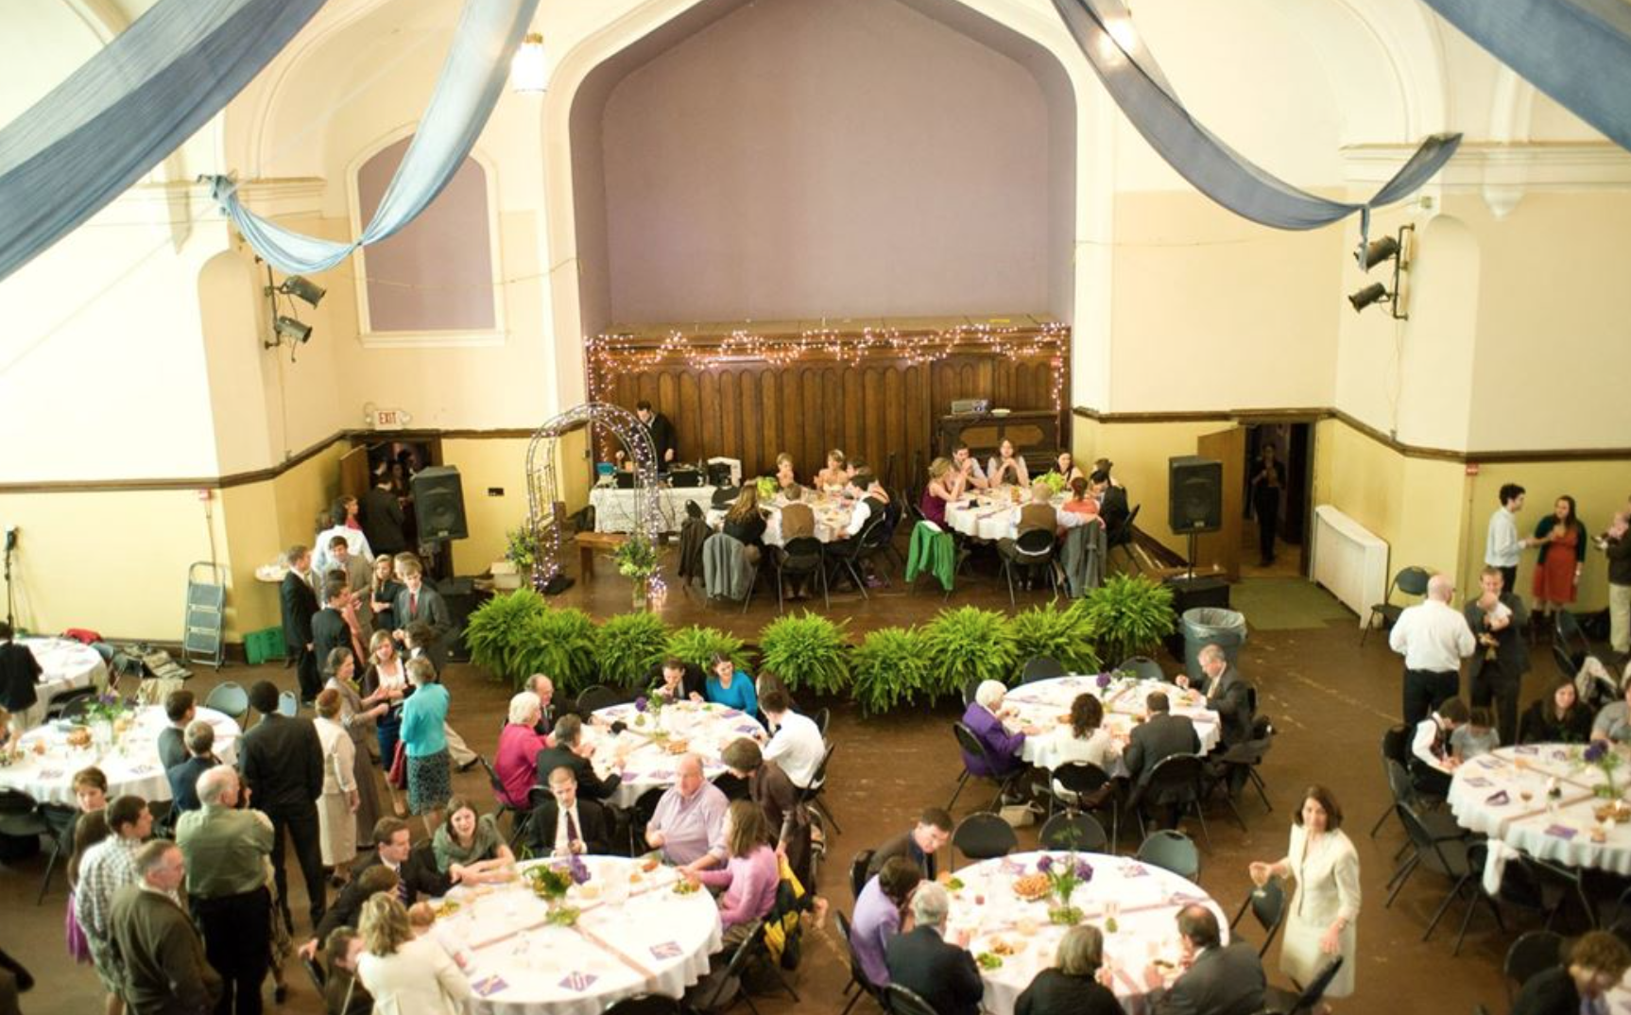
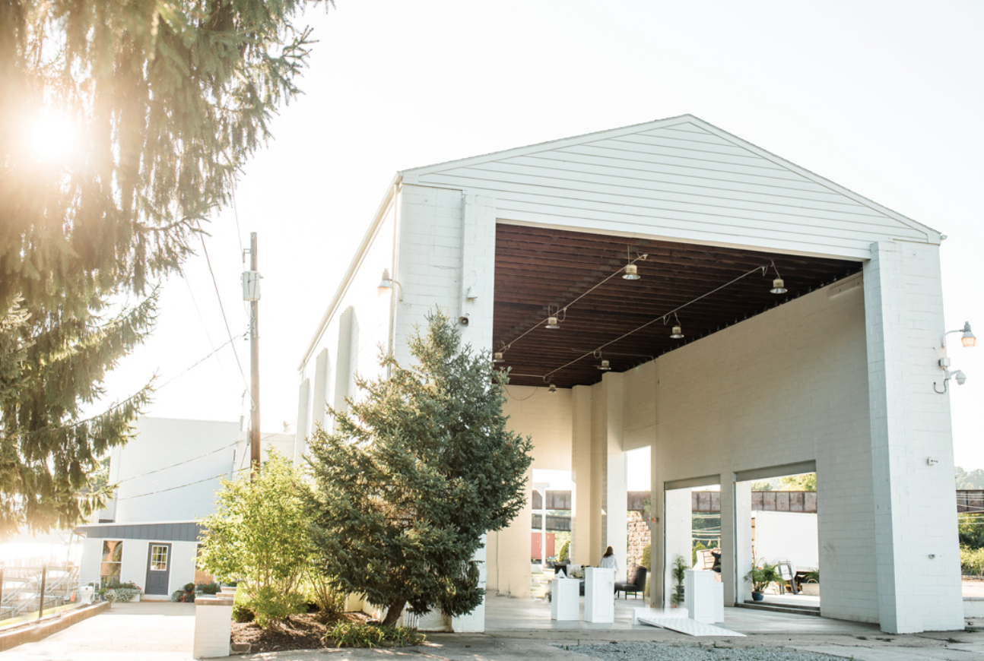
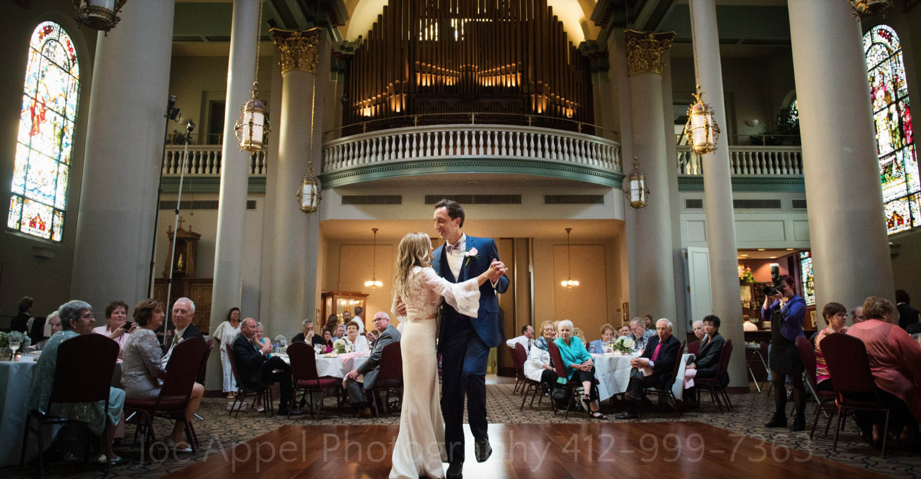
Event Hall Competition

Slide 8
Lots of Bus Stops!
Within 5 Minute Walk
East Liberty Boulevard + Larimer Avenue (74, 75, 89)
5 - 10 Minute Walk
Highland Avenue + Station Street (71B)
Penn Avenue + Sheridan Street (71C, 74, 77, 82, 86, 88, 89)
East Liberty Boulevard + Frankstown Road (82, 86, 77)
East Liberty Transit Center (P1, P2, P3, P10, P12, P16, P17, P67, P68, P69, P71, P76, P78)

Slide 9
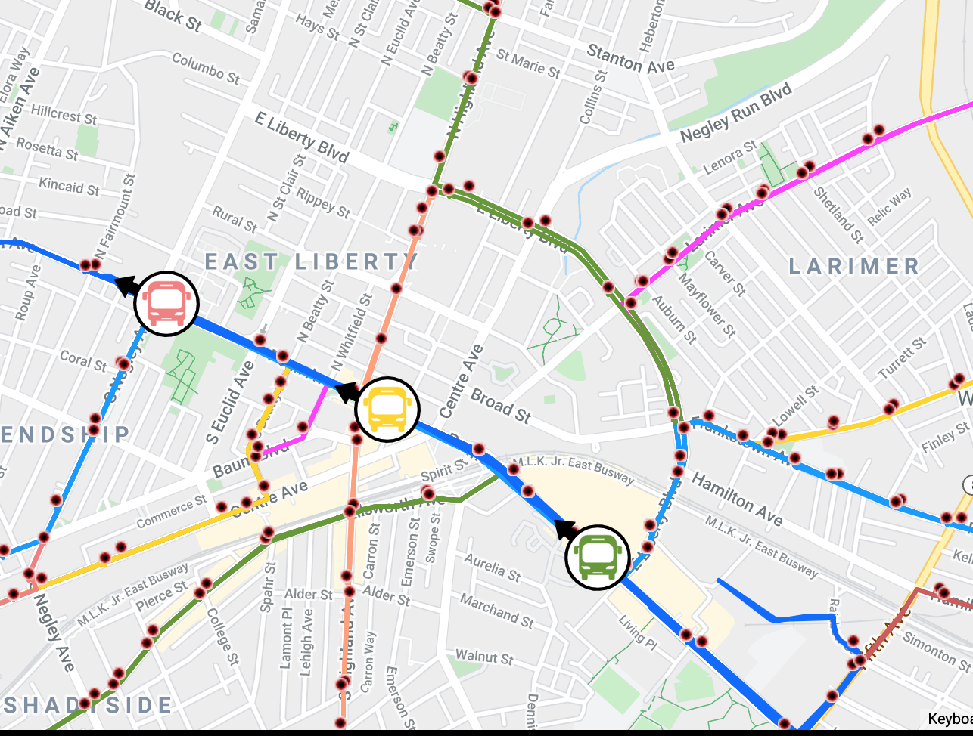
Bus
Access

Slide 10
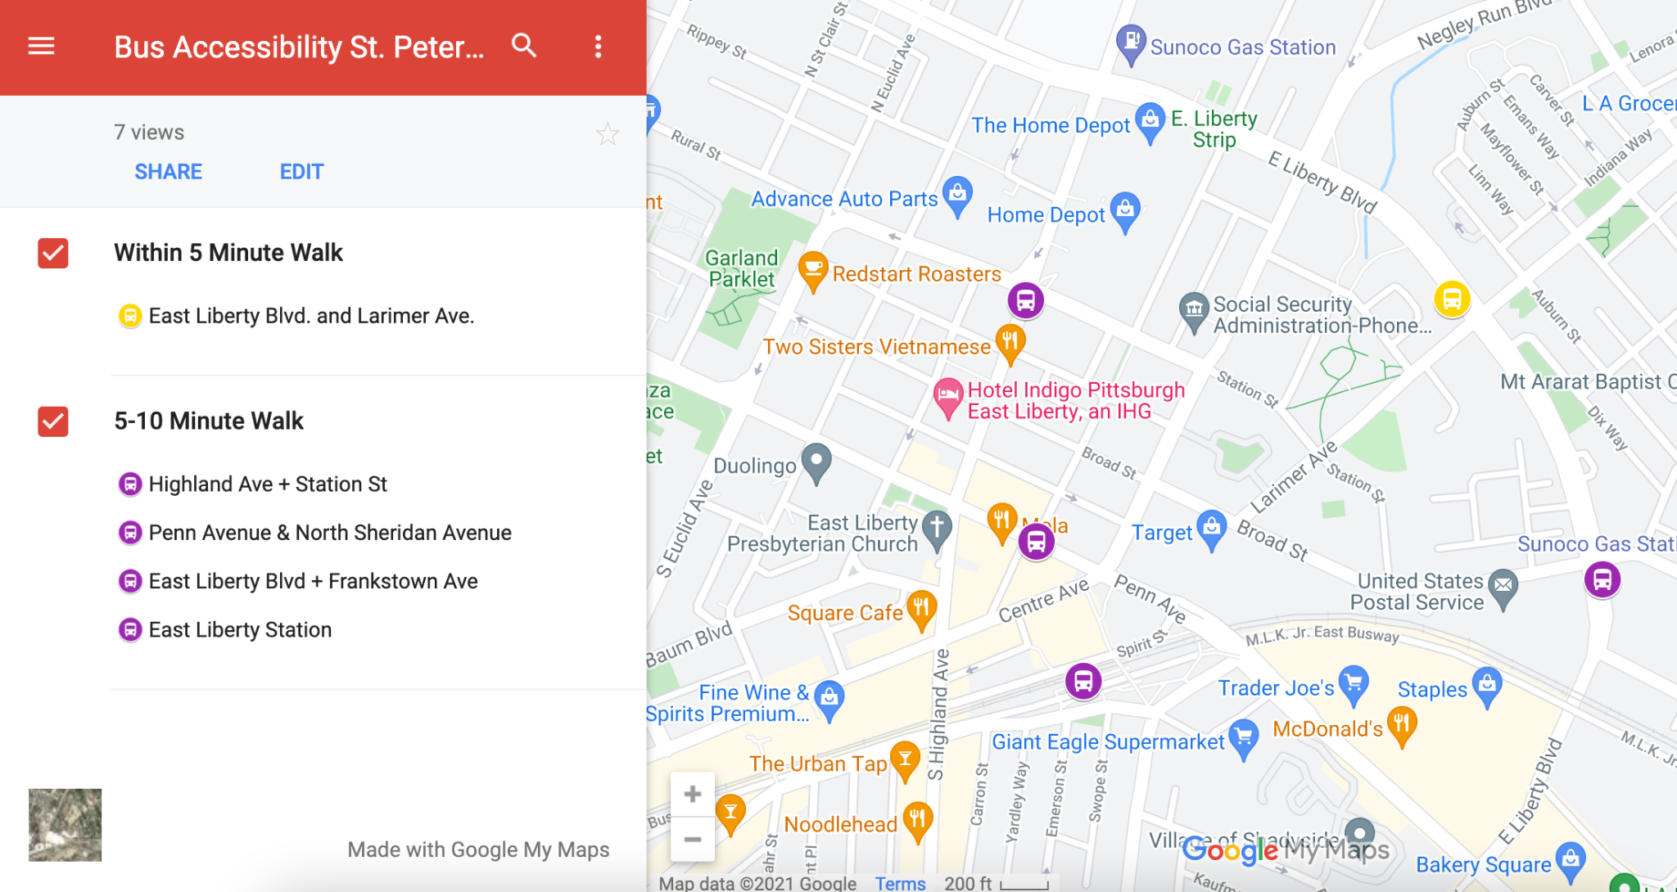
Bus Stop Map

Slide 11
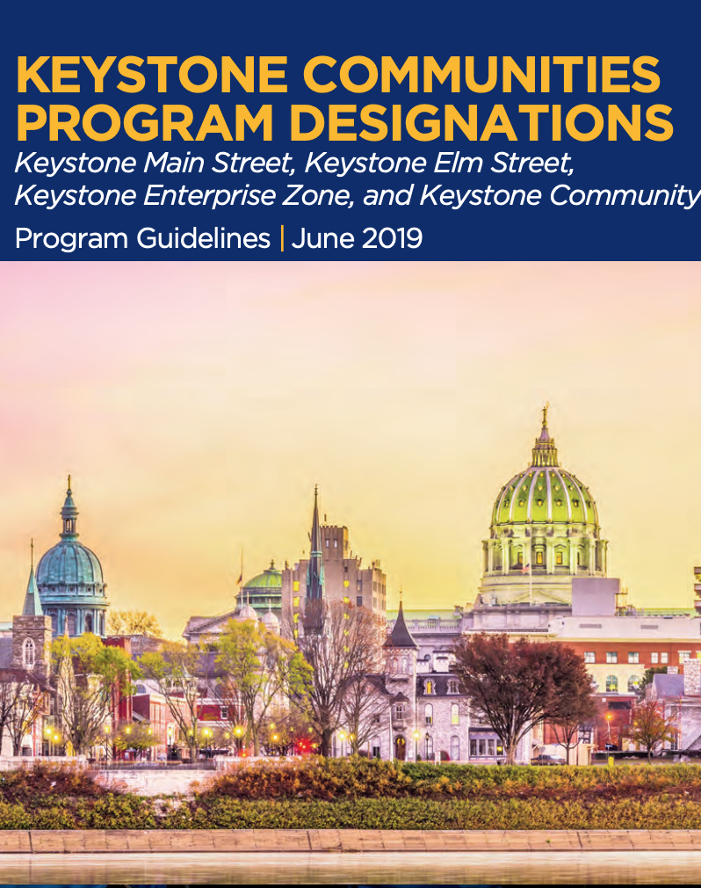
Additional Funding Source
Keystone Communities Program
Pennsylvania Department of Community and Economic Development
Description
A flexible tool for use in community and economic development for a variety of uses including planning activities, façade grant programs, accessible housing programs, and development grants.
Eligible Applicants
Nonprofit organizations to include economic development organizations, housing corporations, community development corporations, redevelopment and/or housing authorities.
Notes:
Planning Grants - Implementing a business development survey in preparation of a business development strategy and/or preparation of the business development strategy
Development Grants
- Rehabilitation or restoration of older or under-utilized buildings for immediate reuse supporting other community development goals,
- Or Redevelopment of an anchor building in a community. To be considered an anchor building, the building must be: – Located within or close by the traditional business district supporting the downtown, – Larger than 10,000 square feet, – Vacant or underutilized, and – Considered by the community to be an important downtown building vital to the downtown’s health.
Development grants may not exceed $500,000 or 30% of project costs, whichever is less.
EXPLORE THIS FURTHER

Slide 12
Possible Keystone Grant Types
Planning Grants
Implementing a business development survey in preparation of a business development strategy and/or preparation of the business development strategy. This grants may not exceed $25,000.
Development Grants
Rehabilitation or restoration of older or under-utilized buildings for immediate reuse supporting other community development goals.
Redevelopment of an anchor building in a community. To be considered an anchor building, the building must be:
Located within or close by the traditional business district supporting the downtown
Larger than 10,000 square feet
Vacant or underutilized
Considered by the community to be an important downtown building vital to the downtown’s health.
This grants may not exceed $500,000 or 30% of project costs, whichever is less.
Note: Contact Johnna Pro (jopro@pa.gov) to confirm eligibility and terms.

Slide 13
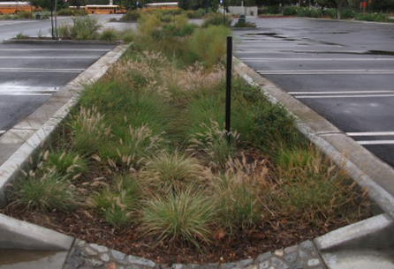
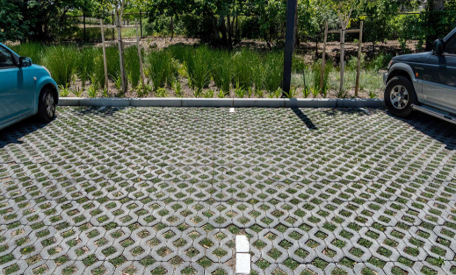
Stormwater
Minor risk of flooding over the next 30 years, which means flooding is likely to impact day to day life within the community.
Recommendations
Create rain gardens to reduce flash flooding by collecting rainwater and allowing time for the water to be absorbed or carried away
Add Bioswales
Add pervious pavers to the parking lot to help drain water, limit runoff, and reduce flooding
Maintain regular upkeep of storm drains and curbside gutters, including removal of fallen branches
Visit the area during/right after a storm to collect better information

Slide 14
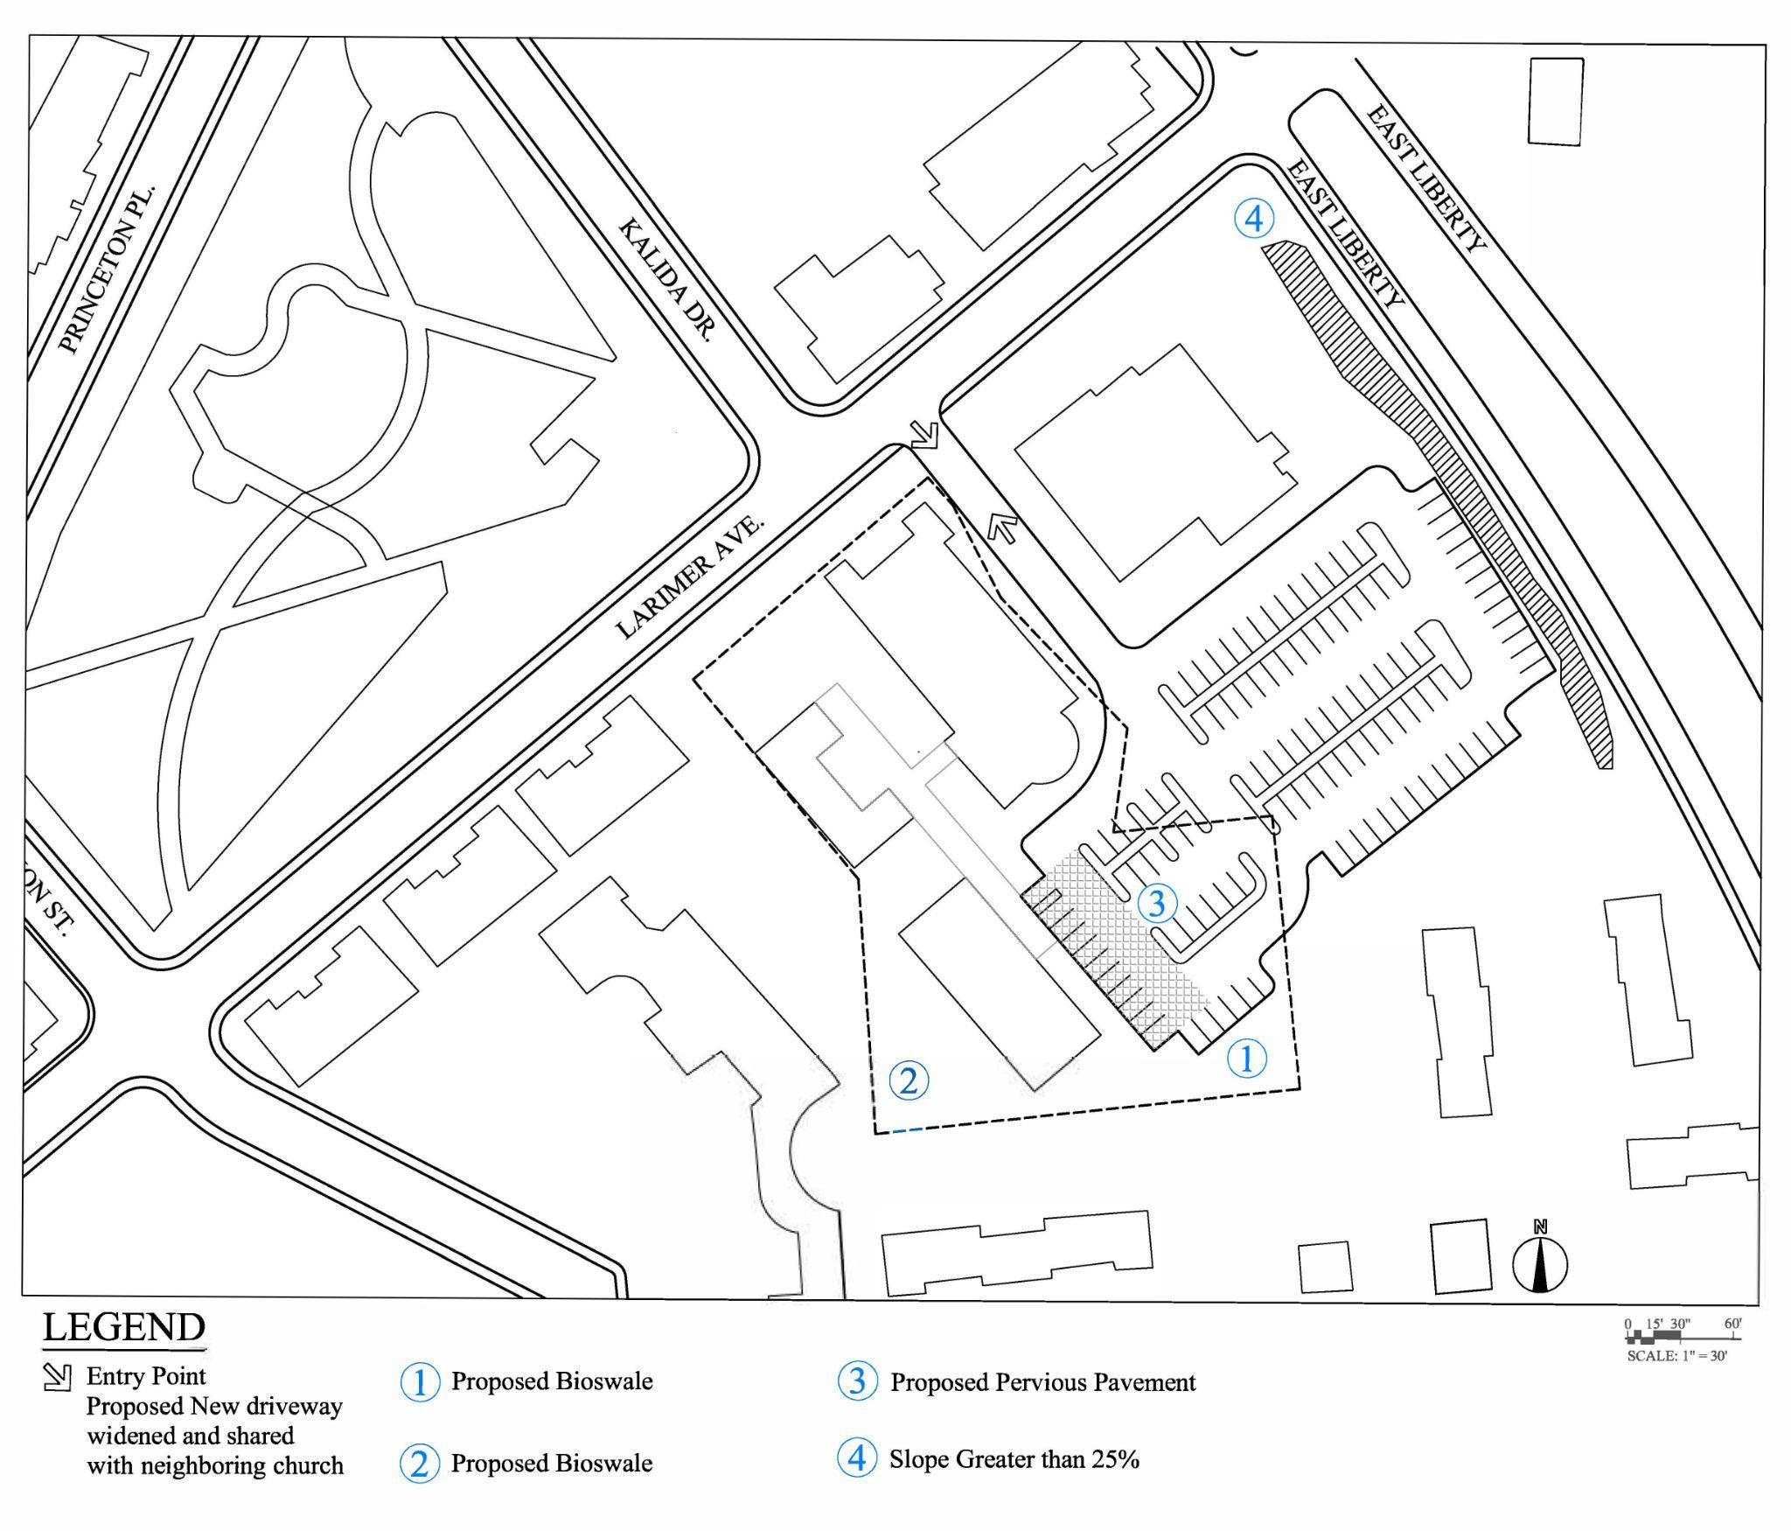
Proposed Site Water Management
and Topography
Proposed bioswales
Alternate location for bioswale
Proposed pervious pavement
Neighboring site along East Liberty has a slope greater than 25%

Slide 15
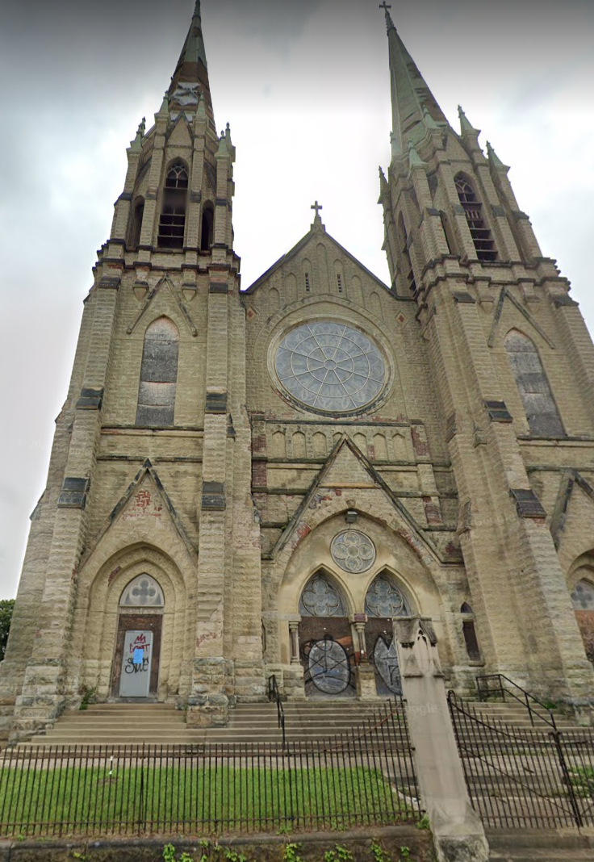
Further Research and Next Steps
Interview potential users about event hall demand, amenities, and pricing
Discuss parking sharing agreement with Pentecostal Church
Research Residential Plan Zoning Type
Inquire about and apply for a variance from the city to get a read on viability

Slide 16
Sources
“Allegheny County ArcGis Viewer.” Allegheny County, 2021. https://www.arcgis.com/apps/webappviewer/index.html?id=b4b1dbb65b4943538425bb5ae0f8f62b.
“Allegheny County Real Estate Portal.” Allegheny County, 2021. https://www2.alleghenycounty.us/RealEstate/Default.aspx
“Event Rentals.” Union Project, 2021. https://unionproject.org/event-rentals/.
“Flood risk overview for East Liberty.” FloodFactor, 2021. https://floodfactor.com/neighborhood/east-liberty-pennsylvania/8937_fsid
“Keystone Communities Program (KCP).” Pennsylvania Department of Community and Economic Development, 2021. https://dced.pa.gov/programs/keystone-communities-program-kcp/
“Pittsburgh’s Grand Hall at the Priory.” Priory Hospitality Group, 2020. http://www.pittsburghsgrandhall.com/#
“Pittsburgh, PA.” Municode. https://library.municode.com/pa/pittsburgh/codes/code_of_ordinances?nodeId=PIZOCO_TITNINEZOCO_ARTIIBAZODI_CH903REZODI_903.01GE.
“Pittsburgh Plans Liberty Green Park for Stormwater Management.” Stormwater Solutions, May 25,2018.https://www.estormwater.com/low-impact-development/pittsburgh-plans-liberty-green-park-storm-water-management
“Pittsburgh Zoning Map.” City of Pittsburgh. https://gis.pittsburghpa.gov/pghzoning/.
“Riverfront Weddings.” Riverfront Weddings, 2021. https://www.riverfrontweddings.com/
“Schedule Finder.” Port Authority https://www.portauthority.org/schedule-finder/
“St. Nick’s Cathedral.” Eventective, 2021. https://www.eventective.com/pittsburgh-pa/st-nick-s-cathedral-room-435238.html.
“The Circuit Center and Ballroom.” The Fluted Mushroom, 2021. https://www.flutedmushroom.com/the-circuit-center-and-ballroom

